Slide 1
Essential Biodiversity Variables: towards an agreement on a common approach for biodiversity
Rob Jongman, Wageningen UR
Henrique Pereira, University of Lisboa

Slide 2
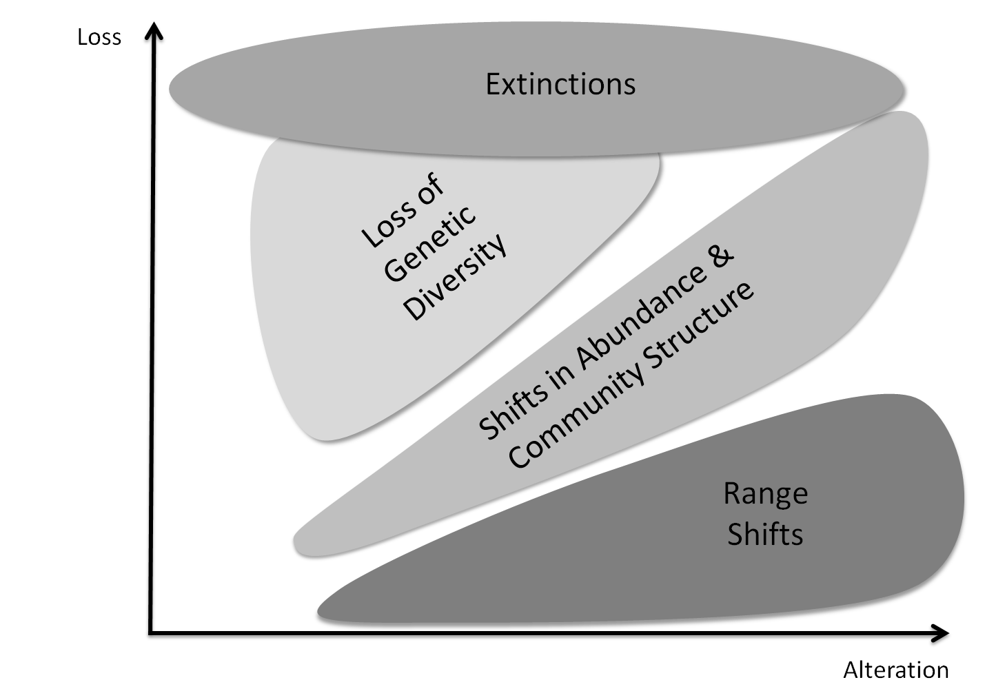
The complexity of biodiversity change

Slide 3
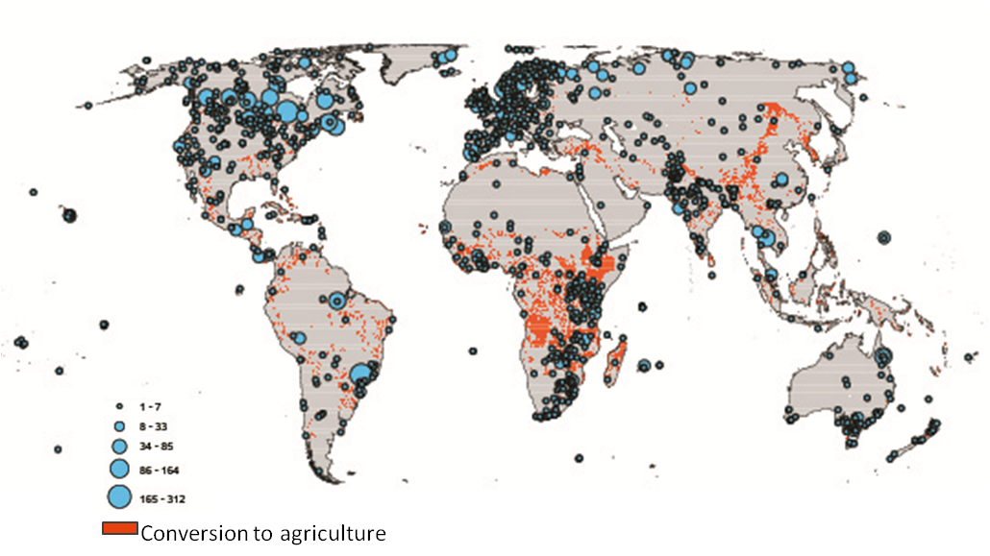
Gaps in biodiversity monitoring
Living Planet Index Populations

Slide 4
2020 CBD goals: CBD as client for biodiversity information
The CBD has defined 20 targets structured around 5 major strategic goals including underlying causes, direct pressures, state, benefits, and responses
Countries have to monitor progress towards each of the targets, but
Many countries are just starting up or revising their biodiversity observation programs
Countries and organizations often need guidance for setting up biodiversity observation programs
For international comparison of biodiversity data the scientific community and data users need to agree on what variables should be monitored for models and indicators

Slide 5
The need for Essential Biodiversity Variables (EBVs)
Can the observations needed to derive the >100 indicators be organized into a relatively small number of Essential Biodiversity Variables?
Each essential variable talks to multiple indicators and targets and
Indicators and targets are informed by multiple essential variables
These variables could be consistently monitored and reported at the national scale by the parties, and contribute towards assessing both national targets and global targets

Slide 6
The questions EBVs must help to answer through input in models and indicators
What is the magnitude of extinction and biodiversity change in time and space?
How does biodiversity respond to the change in the major drivers (land use change, climate change, etc.)?
What are the human consequences of changes in biodiversity, and are the levels of change beyond which the consequences abruptly increase?
Are the collective actions we take to protect and restore biodiversity effective?

Slide 7
Essential biodiversity variables
Characteristics of EBV’s
Ability to detect change
Quantifiable
Repeatable
Allow aggregation and disaggregation
Biological
State
Cover the different dimensions of biodiversity
Genetic diversity
Species populations and distributions
Ecosystems, ecosystem functioning and ecosystem services

Slide 8
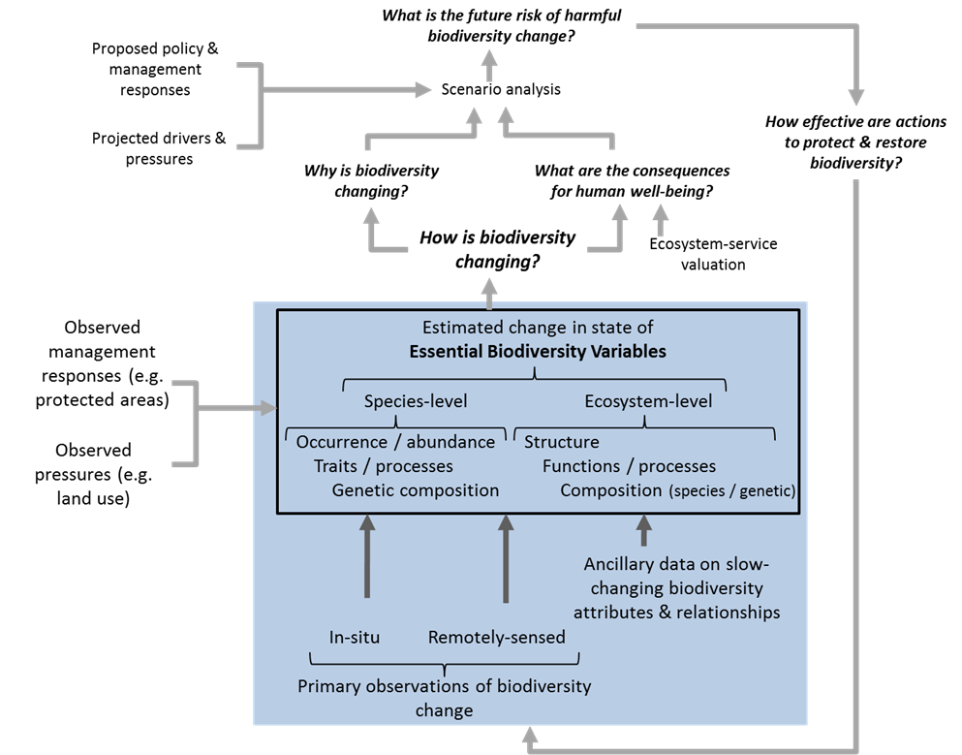
The Position of EBVs in a societal context

Slide 9
EBVs relations with AICHI Targets and CEO

Slide 10
CBD Targets and GEO SBA Map
Aichi Biodiversity Targets
Strategic Goal A
Strategic Goal B
Strategic Goal C
Strategic Goal D
Strategic Goal E
7. Agriculture, forest
13. Genetic diversity
15. Climate change
3. Incentives for BD
6. Marine resources
10. Coral reefs and
11. Protected areas
Strategies & Action
1. Awareness of
other threatened
16. Access and
9. Alien species
12. Threatened
17. National BD
and aquaculture
14. Ecosystem
19. Knowledge
2. Value of BD
4. Sustainability
Benefit Sharing
18. Indigenous
20. Resources
biodiversity
integrated
5. Habitat loss
8. Pollution
ecosystems
knowledge
species
Services
resilience
Plans
sharing
Biodiversity
Water
Climate
Areas/Targets*
Societal
Ecosystem
Benefit
Agriculture
Health
Ocean
cutting
Land Cover
Cross-
Areas
Forest
Impacts

Slide 11
CBD Targets and GEO SBA Map
Aichi Biodiversity Targets
Strategic Goal A
Strategic Goal B
Strategic Goal C
Strategic Goal D
Strategic Goal E
7. Agriculture, forest
13. Genetic diversity
15. Climate change
3. Incentives for BD
6. Marine resources
10. Coral reefs and
11. Protected areas
Strategies & Action
1. Awareness of
other threatened
16. Access and
9. Alien species
12. Threatened
17. National BD
and aquaculture
14. Ecosystem
19. Knowledge
2. Value of BD
4. Sustainability
Benefit Sharing
18. Indigenous
20. Resources
biodiversity
integrated
5. Habitat loss
8. Pollution
ecosystems
knowledge
species
Services
resilience
Plans
sharing
Biodiversity
Water
Climate
Areas/Targets*
Societal
Ecosystem
Benefit
Agriculture
Health
Ocean
cutting
Land Cover
Cross-
Areas
Forest
Impacts

Slide 12
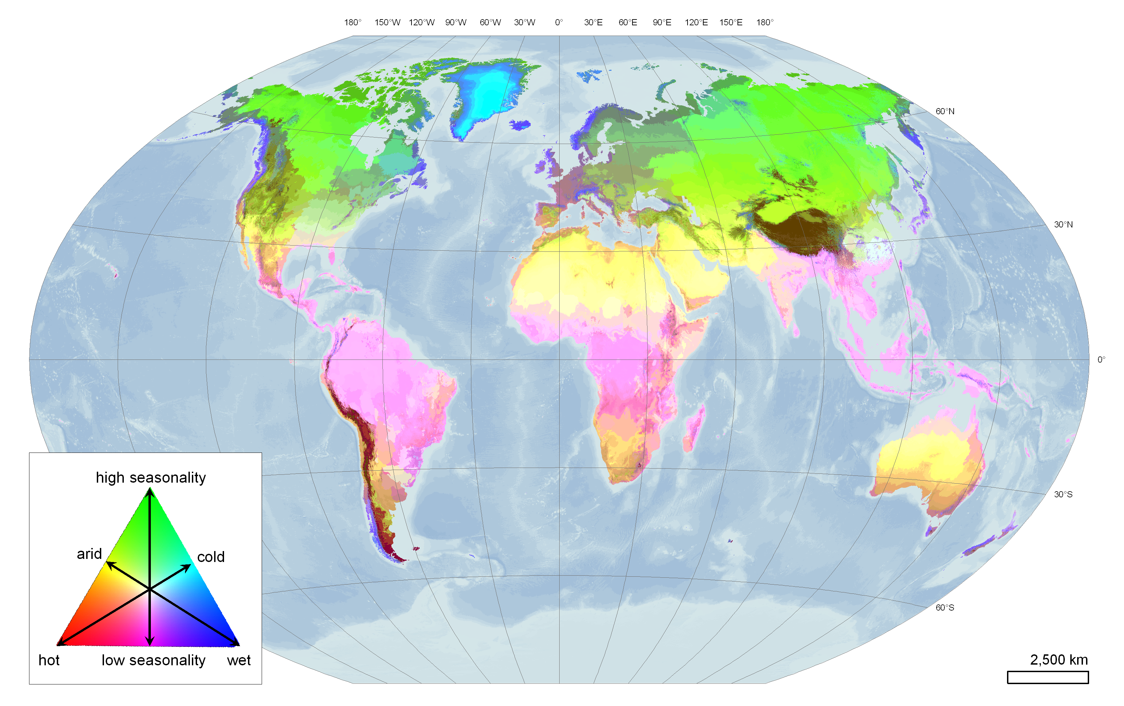
Global Environmental Stratification: Spatial Component
Metzger et al., GEB, 2012

Slide 13
Linking regions (1)
J4 (cool temperate and moist)
Links Bretagne and Cornwall
G8 (cold mesic)
Links Apennines with other Mountains regions
L6 (warm temperate and xeric)
Links the hottest parts of Europe with Africa

Slide 14
Linking regions (2)
R9 (extremely hot and moist)
Links Australian tropics to SE Asia and beyond
P2 (extremely hot and arid)
Links the Gibson with the deserts of Arabia, the Sahel and the Thar desert.
K10 (warm temperate and mesic)
Links Mediterranean regions in Australia with those in Chile, South Africa, California and Europe.

Slide 15
Developing the EBV’s
An on-going process
First steps at GEO BON adequacy report (2011)
ESA-Frascati workshop dedicated to identifying EBV’s with 35 experts (2012)
More meetings to come, emphasizing operationalization
An open process
Feedback is welcome and will be formally requested over the next few months, from scientists and other users
Information is publicly available and major paper in preparation

Slide 16
Next steps for GEO BON
The scheme of Essential Biodiversity variables and its link with indicators and ecosystem services has to be elaborated;
The marine stratification has to be elaborated based on the available products;
For every region in the world EBVs should be identified as well as the minimum number of observations and the way of observation;
Capacity building has to be set up for in situ and RS observations as well as data management;
Data sharing (including technical and political issues) is essential for global reporting.

Slide 17
Coastal and deep sea realms

Slide 18
Relations with other tasks and external links
Drivers: Land and Water use change, GEO agriculture, GEO land cover, GEO ocean, GEO disasters
Pressures: GEO climate, GEO weather, GEO water,
Status: GEO BON, biodiversity status (EBVs), GEO forest, GEO ocean
Impact: GEO BON, Biodiversity change (EBVs). GEO forest, GEO Ocean, GEO water
Response: National governments, CBD, Ramsar, CITES, CMS, WCMC, IUCN

Slide 19
Thank you for your attention
http://www.earthobservations.org/geobon.shtml
http://www.ebone.wur.nl

